Slide 1

A PRESENTATION BY NIPCO GAS LIMITED

Slide 2
INTRODUCTION TO COMPRESSED NATURAL GAS AS A VEHICLE FUEL.
The Compressed Natural Gas (CNG) is a clean economic fuel, used worldwide by both private as well as public transport vehicles. Any vehicle running with gasoline (Petrol) may be converted by means of the installation of an appropriate kit. Upon installation, the vehicle is flexible to be powered with any of the two fuels.

Slide 3
What is CNG
The origin of the Natural Gas is the transformation of the organic matter being its molecular composition of one carbon atom and four hydrogen atom (CH4) , hence received the name of methane: it is called Natural because of its production. It does not require any petroleum distillation process, as it sprouts naturally of wells. The methane is colourless and odourless. Due to this latter feature, it is subjected to an odourization process being given characteristic odour in order to be detected by means of smell in case of leakages.
The methane content used as fuel varies its composition between 80% and 95%, the rest is composed by butane, propane water etc. this difference depends on extraction area and different separation process to which the gas is subjected by the producers.

Slide 4
STORAGE
The natural gas is compressed at 200 bar (3000psi) and stored in cylinder appropriate for this working pressure. The cylinders have different capacities measured in litres in order to adapt to different vehicle trunk space.
COMPARATIVE PERFORMANCE BETWEEN CNG AND GASOLINE
Mechanical power of the vehicle is derived from the internal combustion of fuel ( CNG or Gasoline) achieving energy transformation. below, is the storage capacity and the equivalence in litres of Gasoline and CNG.

Slide 5
CNG cylinder capacity (L) | CNG’s capacity in m³ at 200 bar | Equivalence in litres of gasoline
50 | 11.5 | 13.1
60 | 13.8 | 15.72
65 | 14.95 | 17.03
80 | 18.4 | 20.96

Slide 6
WHY USE CNG?
As on date, CNG converted vehicles are in excess of 4700 in Nigeria. This number is expected to grow owning to the rising cost of PMS and the attendant benefits of CNG, however, certain factors comes into play in its acceptability, which will be discussed shortly in sections of this presentation.

Slide 7
THE BENEFIT OF CNG
The benefit of CNG are of different categories
Economic Benefit:
The cost per KM of CNG is approximately 40% to 50% less when compared to cost gasoline per KM. For an average size 2.0L engine;
On CNG,
Cost per KM is N 13
On PMS
Cost per KM is N 24
The above analysis gives 45% savings. Consequently, as expected, this huge amount of savings will translate to corresponding savings in foreign exchange on importation of petrol, and reduce poverty as running cost of powering vehicle is reduced.

Slide 8
ENVIRONMENTAL BENEFITS
The pollution from exhaust gas of internal combustion engines has been a global concern. Lead, an additive in the production of petrol in other for it to prevent knocking is harmful. Conversely, CNG is free of lead.
The combustion of CNG is cleaner, reducing the emission of carbon monoxide and hydrocarbon (HC)which are both pollutants

Slide 9
BENEFIT WITH RESPECT TO SAFETY
CNG is lighter than air, in case of leakages, it rises rapidly above air, hence not producing dangerous accumulation or water pollution as seen in liquid petrol.

Slide 10
BENEFIT WITH RESPECT TO VEHICLE MAINTENANCE
Petrol from an incomplete combustion in the combustion chamber finds its way through the sleeves to the engine swamp. This cause a reduction is the lubrication properties of the engine oil, which necessitate short service interval. This phenomenon is not present with the use of CNG as vehicular fuel.

Slide 11
BIFUEL FUNCTION
With CNG kit installed, motorist enjoy the liberty of using either fuel to power the vehicle in other words, if one system fails, the other still keeps the vehicle running until repair it done.

Slide 12
BASIC VEHICLE REQUIREMENT FOR INSTALLATION
Spark Ignition: CNG can be used only on vehicle that is equipped with spark ignition system as it requires spark to initiate its ignition. This also means that compression ignition engines cannot be converted to be powered by CNG only.
Engine Compartment: There must be available space inside the engine bay for CNG KIT components to be installed.
Trunk Space : Storage cylinder is usually installed in the boot of the vehicle. It is important that enough space is available for easy access to other items in the boot. For example the spare tyre.

Slide 13
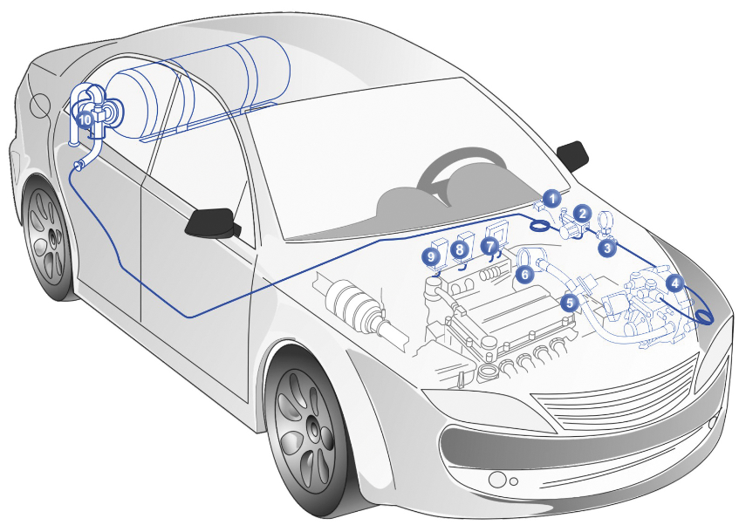
A LAYOUT OF CNG KIT COMPONENTS

Slide 14
CHALLENGES ASSOCIATED WITH THE USE OF CNG
Few CNG stations are available: There is a huge deficit in CNG refueling stations which poses a difficult problem once a converted vehicle leaves the proximity of CNG stations.
Limitation of Storage Capacity: An average cylinder of 60L (14 Standard Cubic Metres ) can do approximately 150km on the high way, therefore to successfully take advantage of CNG as a vehicular fuel, there should be CNG refueling stations at a proximity of about 150km apart.

Slide 15
High cost of CNG kit: CNG kits are imported hence requires foreign exchange with a resulting effect on local currency due to exchange rate. An average conversion kit cost about N250, 000.
Absence of Natural Gas infrastructures: the relative absence of natural gas infrastructure and pipelines in most part of the country removes the potential on the use of natural gas. This also transcend its use as a domestic gas for our homes and alternate standby power generators

Slide 16
Thanks for Listening

